Slide 1
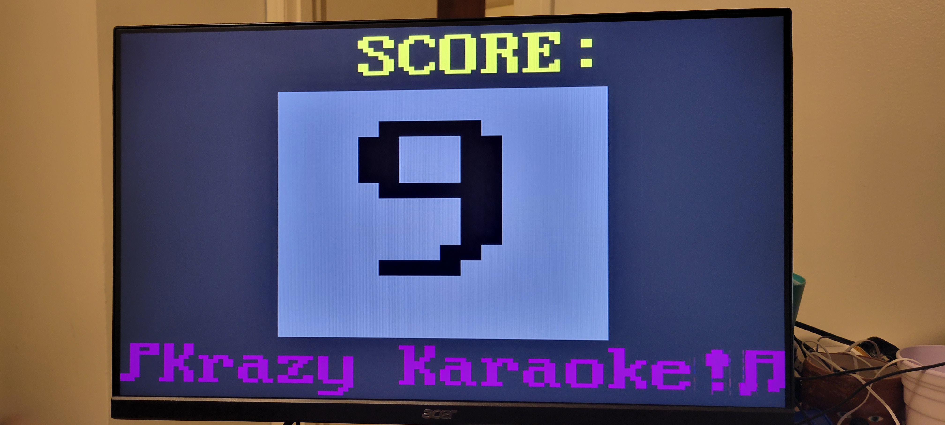
Krazy Karaoke
Ian Chadwick
Joe Biernacki

Slide 2
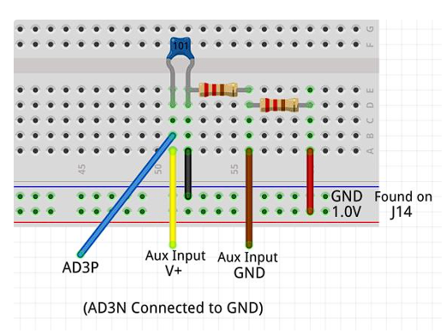


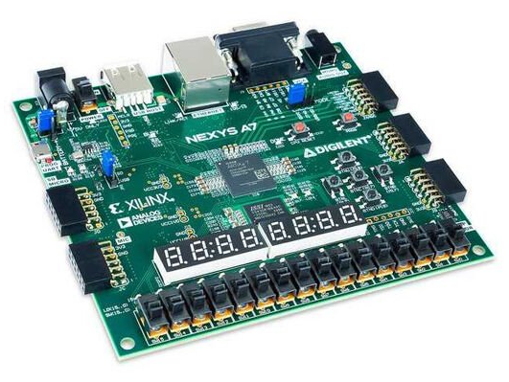


Block RAM
FFT Module
ADC
PWM Conversion

Slide 3

Ref FIFO
Score Module
Tally Module
VGA Module
FFT Module
Song FIFO

Slide 4
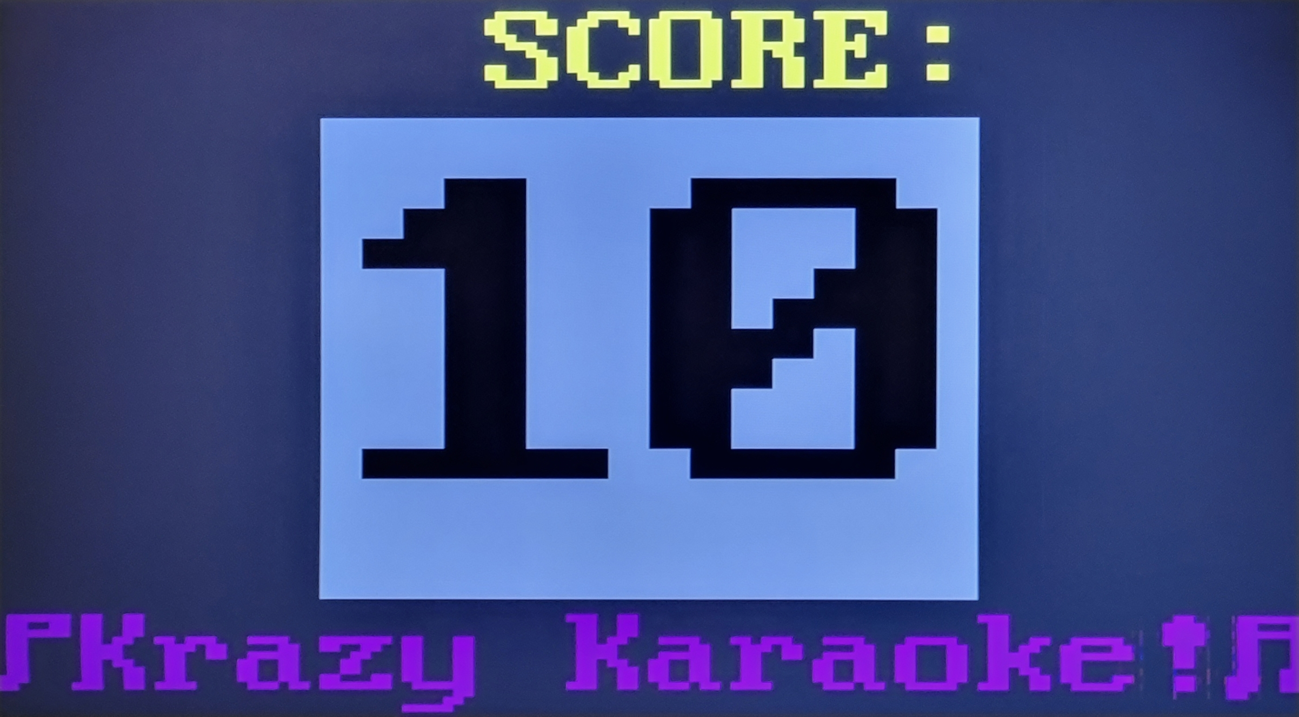
5x5 pixels
20x20 pixels
5x5 pixels

